Slide 1
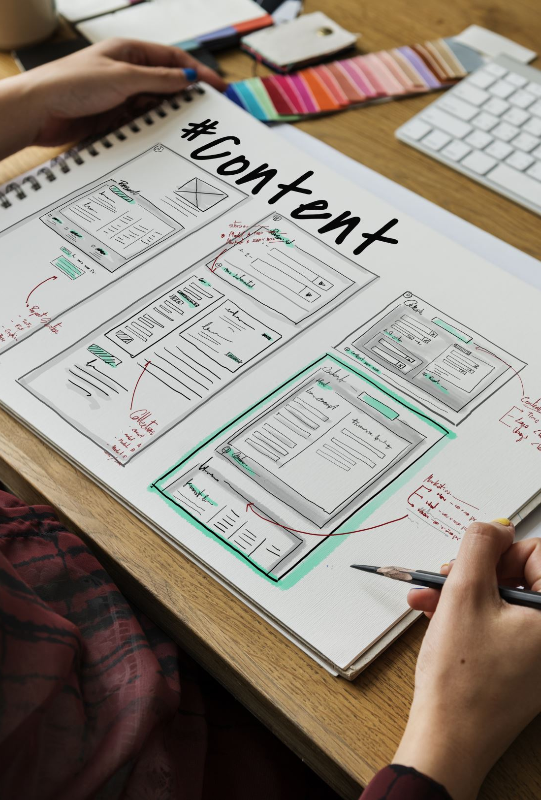
Iterative and Agile Software Development: part 1
Professor Greenwell, CEN 3031

Slide 2
Classic Models
A Summary

Slide 3
Summary of Classic Models
Models helped standardize software development lifecycles (SDLC)
Some did not adapt well to software cycles (too slow, not adaptable)
Waterfall
Some still useful and used today
V-Model
Spiral
Setup Phases shared between models

Slide 4
Rapid Application Development
FROM Which we get Spiral and began looking to unified processes

Slide 5
Iterative Classic models
(RAD) Prototyping
Develops a series of prototypes used to test and finalize development of product.
Develops a series of prototypes used as a proof-of-concepts which are destroyed or archived after completion in conjunction with other SDLC model.
Unified Process
Based on the idea that SDLC should be a collaboration between different, unified, processes.
Broke project into phases and work (tasks) into disciplines. Then further broke down phases into iterations which allowed multiple tasks to be assigned to teams based on their discipline.

Slide 6
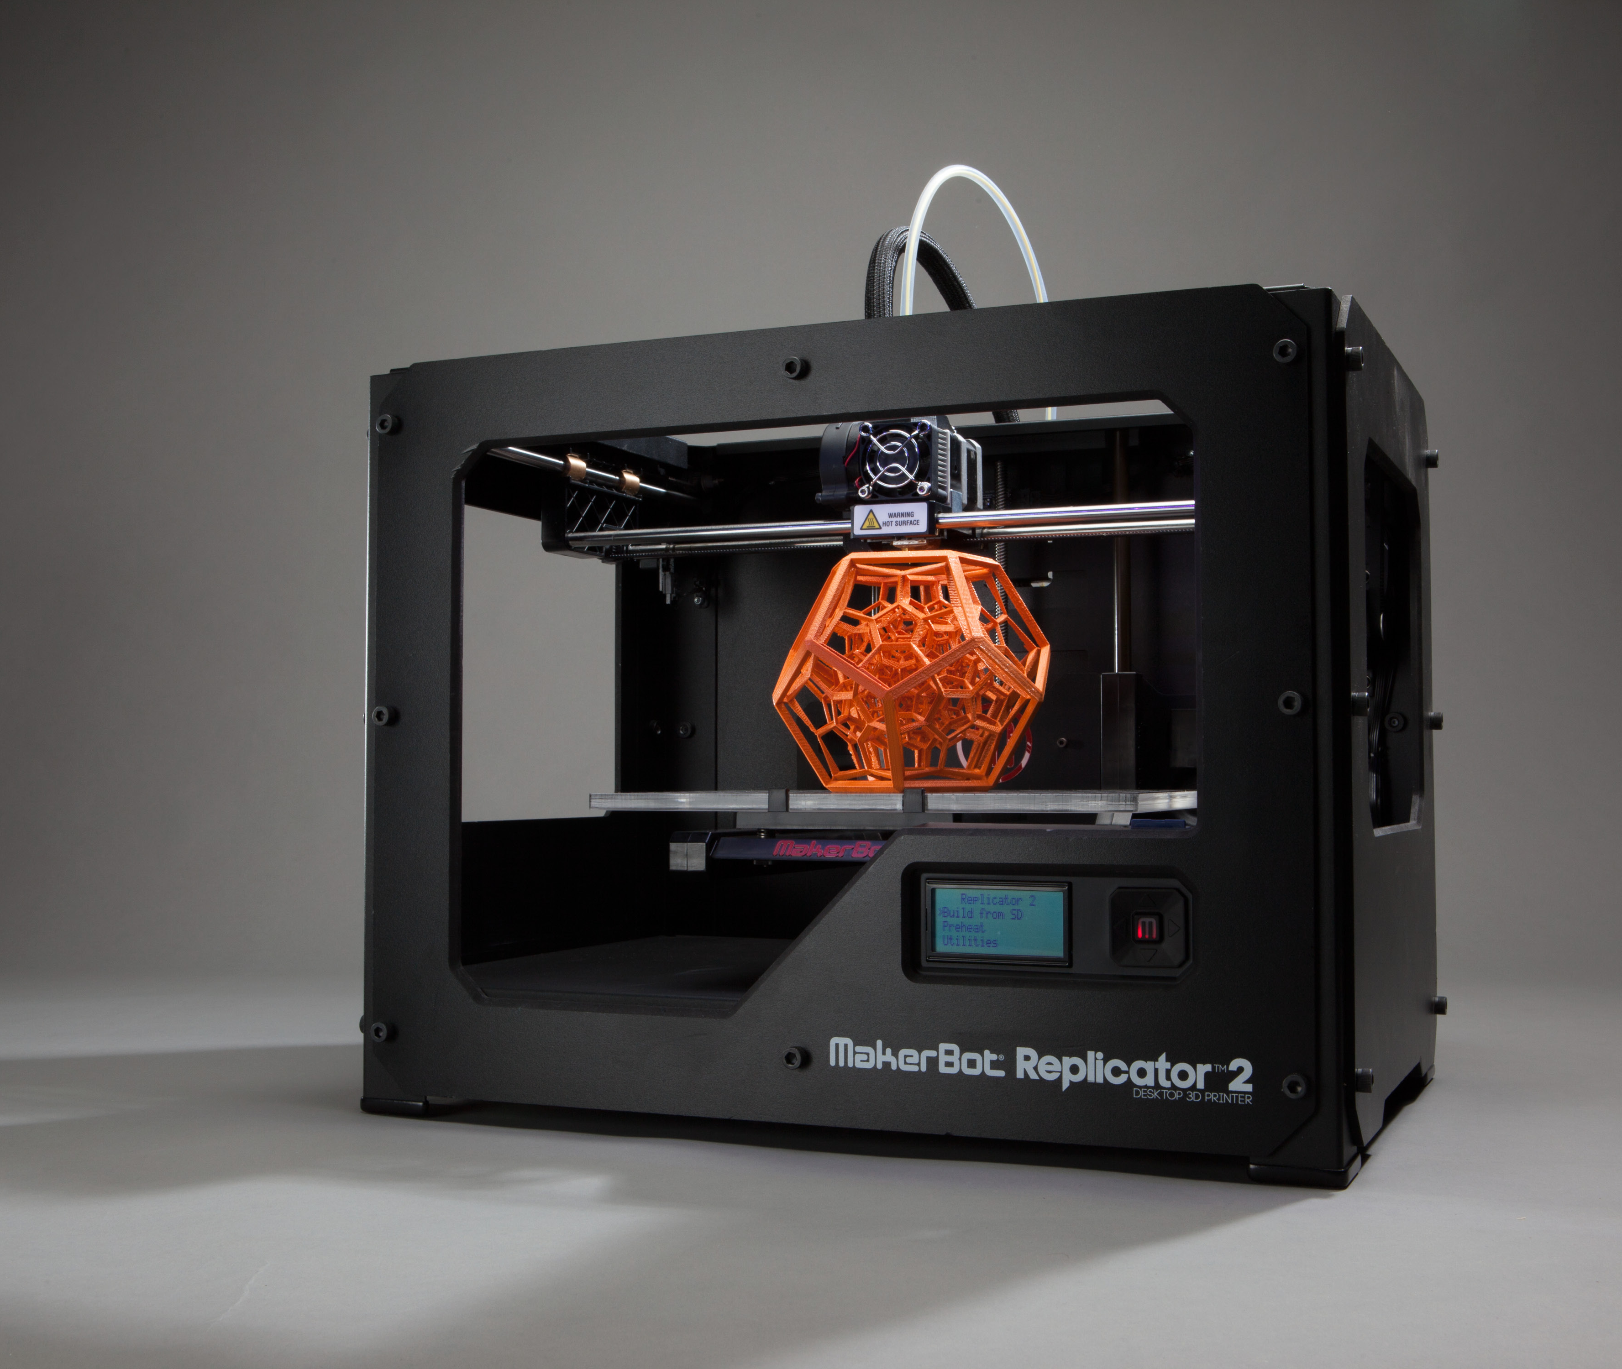
Rapid Prototyping history
So rapid prototyping comes from actual engineering (manufacturing) and is still used today.
Where parts of a whole unit were created to ensure:
Fit
Correct design
Client likes design
It's increased in usage due to 3d printers (makes prototyping cheap)
This led to 2 development ideas in SDLC: Prototyping and Rapid App Development
This Photo by Unknown author is licensed under CC BY.

Slide 7
Standard Prototyping (used with all models)
Prototypes made for feedback
Low-fidelity
High-level (design documents, UX pictures, blueprints, etc)
High-fidelity
Usable part of whole
For checking
Includes demos and alpha/beta
User's approval
Testing
Market (expo version)

Slide 8
Rapid Application Development (RAD) in SDLC
Late 80s-91: First RAD developed.
Changed emphasis from the planning of waterfall to a focus on development
Can have little planning
Prototypes are used as the design specifications
Original version Reduced Waterfall to 4 phases
Requirements Planning
User Design & Construction
Cutover

Slide 9
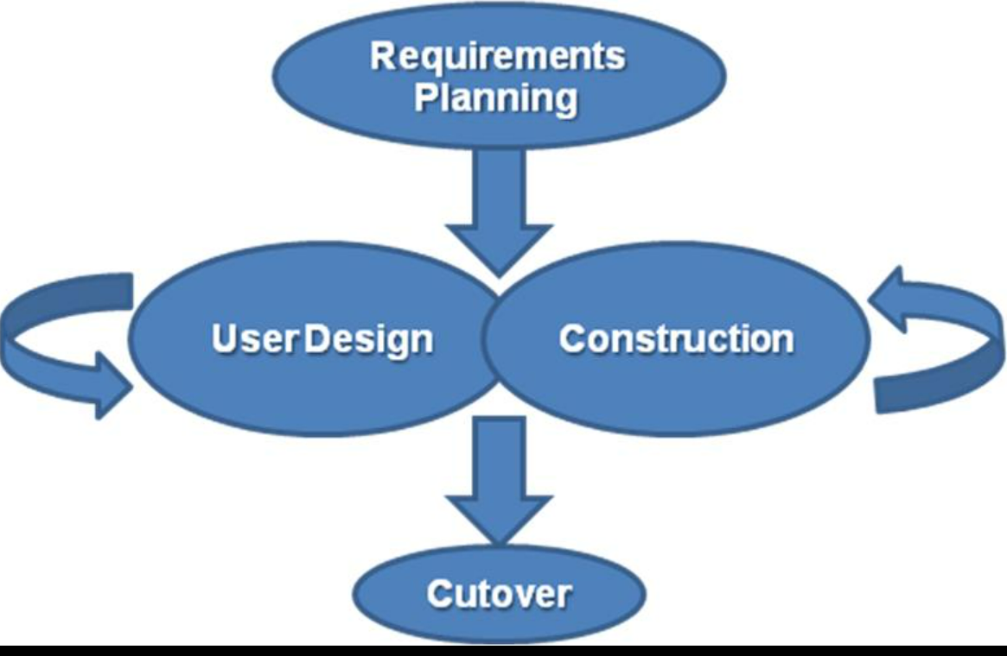
RAD Phases
Start
Requirements, analysis, and design all completed in single phase
Ends when client and management agree on design
Repeat until done
Construct prototypes and receive user feedback (continually) on these until a final product is reached
Cutover
Compressed Final stages, including training

Slide 10
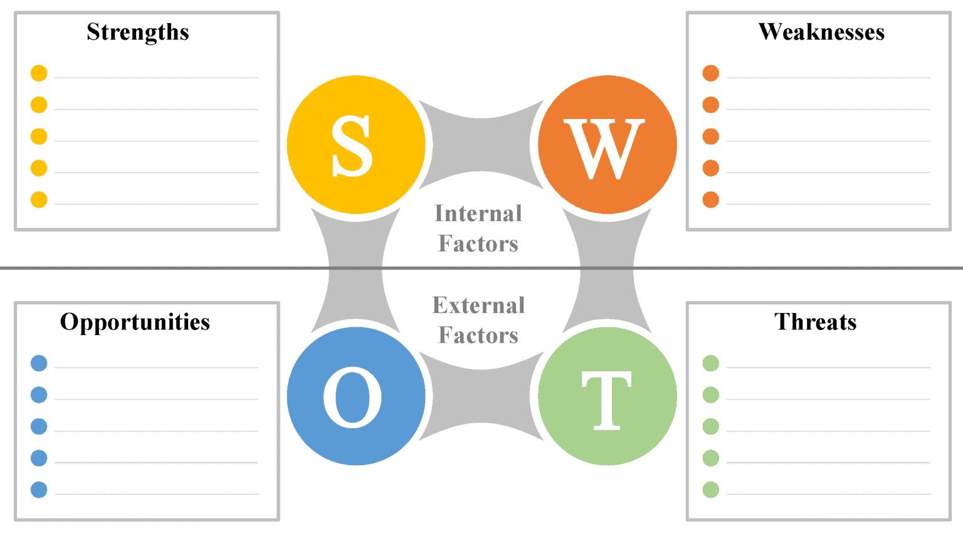
Faster Development (1st to market)
More client interaction
Buy-in (hype)
Documentation of Non-functional requirements
More difficult integration testing
Scaling and scope issues more likely
Leaks and Stolen code
Team communication
Non-functional requirements documentation
This Photo by Unknown author is licensed under CC BY-SA.

Slide 11
Unified Process Model
Includes: Rational, basic (Open), and eventually agile

Slide 12
Based on Core Principles
Iterative Development
Use Cases/Scenario drive development
Risk Management integration
Architecture-Centric Approach (Use Components like OOP)
Model Visually
Control Changes

Slide 13
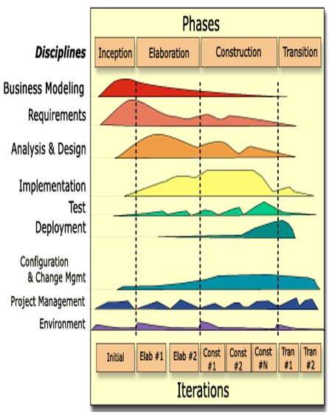
Rational Unified Process (complex)
4 phases split into N iterations
Each ends with a “milestone”
Point was to end project if not “feasible”
Check at milestones
End project if outlook too bad
Or Shift or add or change milestones
More of a framework
Everything is a least a little bit in each stage

Slide 14
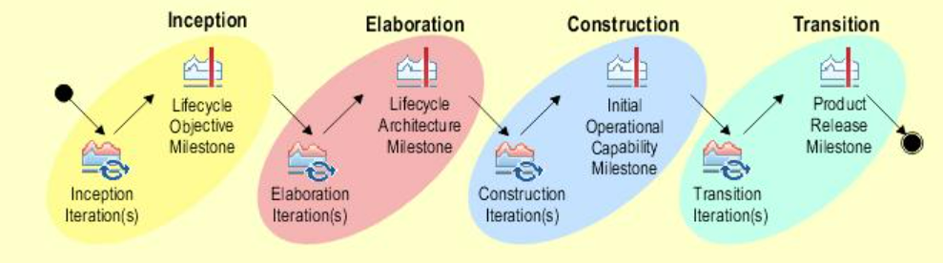
Simplified OpenUP
Removed Optional Parts of RUP
Still keeps core principles (with focus):
Use-case drive development
Use Components
Iterative Development
Risk Management
3-6 people for 3-6 months

Slide 15
AGILE Unified Process (mixes RAD & UP)
Individuals
Over processes
Working software
Over documentation
Collaboration
Over contract negotiation
Responding to change
Over following a plan
Based on 12 principles and the AGILE Manifesto (in modules):

Slide 16
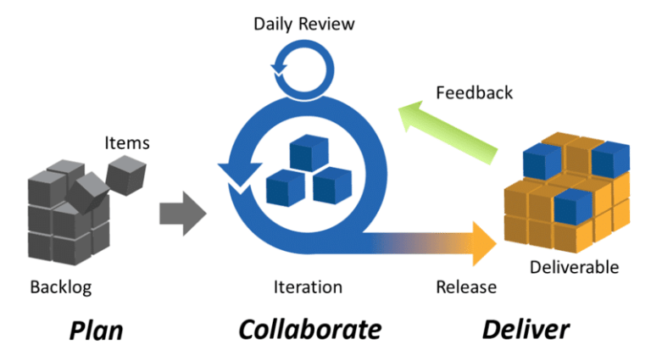
Phases of Agile (4 to 3)
This Photo by Unknown Author is licensed under CC BY-SA
This Photo by Unknown Author is licensed under CC BY

Slide 17
SWOT
2008
So Agile started in 2001 (before but that's when it was named at a conference) and a few researchers performed a SWOT on it in 2008 which was pretty bleak.
2022
Let's compare that to 2022 when a version of Agile is used for 71% of software projects.

Slide 18
Versions of Agile (we'll look at 3)
Scrum
Extreme Programming
Feature-Driven Development (FDD)
Dynamic Systems Development Method (DSDM)
Crystal
SAFe Lean

Slide 19
From here
Wednesday we continue Agile
Quiz on this content is live now
Continue working on project

